Slide 1
Effect of Global Warming on Long-Term Sea Level Change in Tuvalu
H-H
Team H-H:
Huanyue Liao, Hanyu Wang
Notes:
https://us05web.zoom.us/j/84148214410?pwd=NDV2MDlUTVkydmVVNnErOU02MGI0QT09

Slide 2
H-H
Section 1 [maximum 1 slide] - Motivation and Executive Summary
Section 2 - The machine learning morphism of your solution
Section 3 - The validation framework and results
HUSH

Slide 3
Motivation and Executive Summary
Decisions:
Relocation and resettlement of residents
Adaptations to slow down the sinking
Reference for other sinking countries
Advocating for actions to mitigate global warming
Business Values:
Markets of the other countries
Innovations in renewable energy
Global support and financial aid
Reference for other sinking island countries

Slide 4
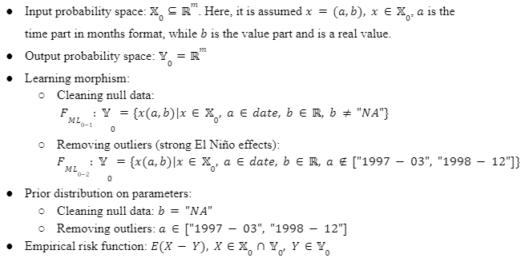
MLM: ML0: Data Cleaning

Slide 5
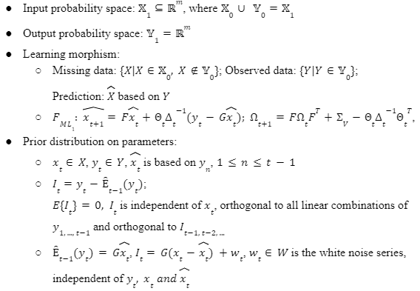
MLM: ML1: Kalman Filter - 1

Slide 6
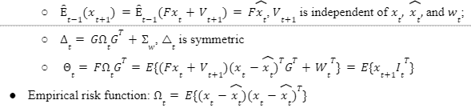
MLM: ML1: Kalman Filter -2

Slide 7
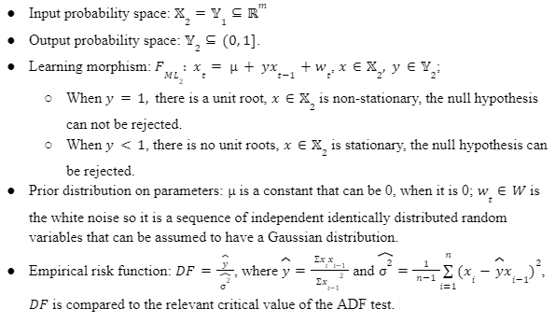
MLM: ML2: ADF Test

Slide 8
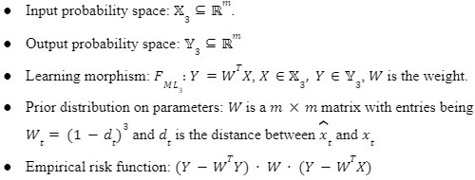
MLM: ML3: Loess Model

Slide 9
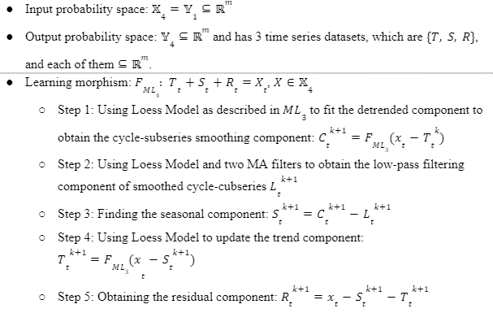
MLM: ML4: STL Decomposition Model - 1

Slide 10
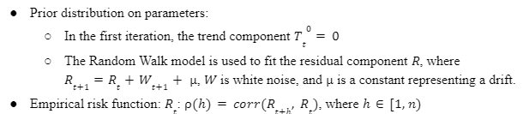
MLM: ML4: STL Decomposition Model - 2

Slide 11
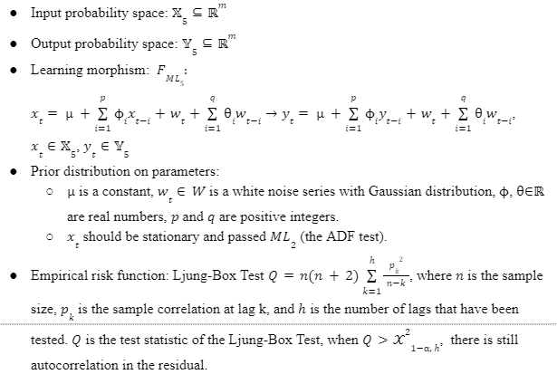
MLM: ML5: ARMA Model

Slide 12
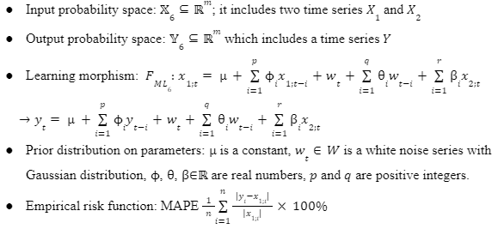
MLM: ML6: ARIMAX Model

Slide 13
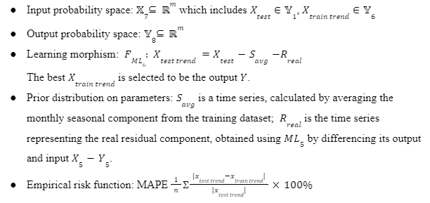
MLM: ML7: Performance of ML6

Slide 14
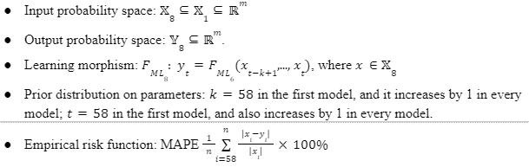
MLM: ML8: Forward Rolling-window

Slide 15
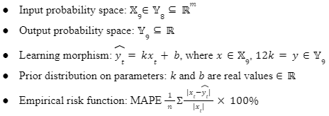
MLM: ML9: Linear regression

Slide 16
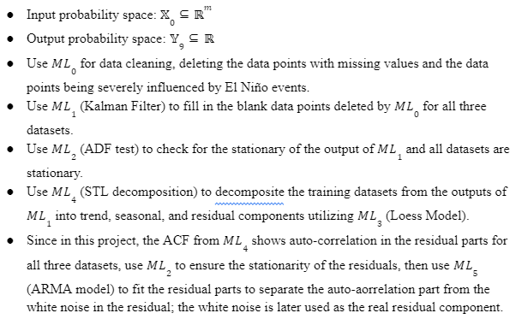
MLM: Workflow - 1

Slide 17
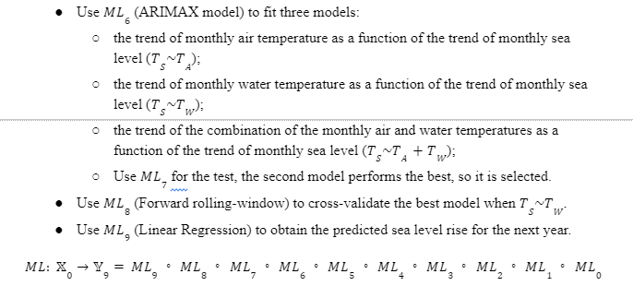
MLM: Workflow - 2

Slide 18
The validation framework and results
ARIMAX(p,d,q) in the candidate list
Loop over all pairwise values of
AR order p∊{0,1,2,3,4,5},
the degree of differencing d∊{0,1},
MA order q∊{0,1,2,3,4,5}.
Calculate MAPE,RMSE.
 | p | d | q | (p,d,q)
1 | 0 | 0 | 0 | (0,0,0)
2 | 1 | 0 | 0 | (1,0,0)
3 | 2 | 0 | 0 | (2,0,0)
… | … | … | … | …
72 | 5 | 1 | 5 | (5,1,5)
Choose ARIMAX order (p,d,q) with the lowest mean absolute percentage error (MAPE) by using time series cross-validation.
There are 72 groups of orders in the total.

Slide 19
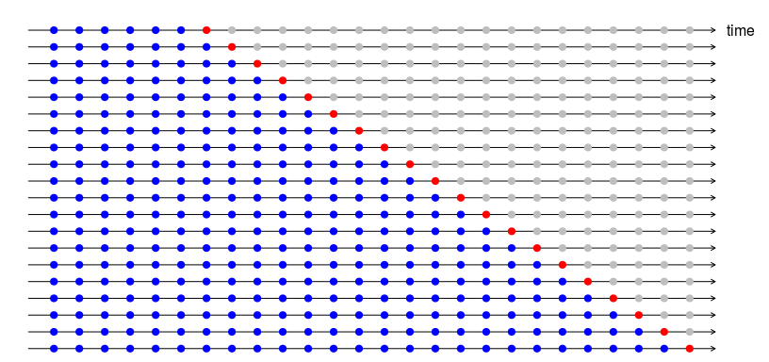
The validation framework and results
ARIMAX: Rolling-window Time Series Cross Validation
perform walk-forward validation on sea level time-series trend data..
Sea Level Data: training data length 232, test data length 58.
The primary training part is length as 232/2=116.
We set the length of validation part as 1 (red point).
The forecast accuracy is computed by averaging over the test sets. This procedure is sometimes known as “evaluation on a rolling forecasting origin” because the “origin” at which the forecast is based rolls forward in time.
train dataset
validation dataset
Notes:
Cross-validation for time series is different from machine-learning problems that time or sequence is not involved. In the case of the absence of time, we select a random subset of data as a validation set to estimate the accuracy of the measurement. In time series, we often predict a value in the future. Therefore, the validation data always has to occur after the training data.

Slide 20
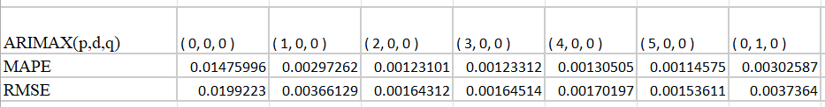
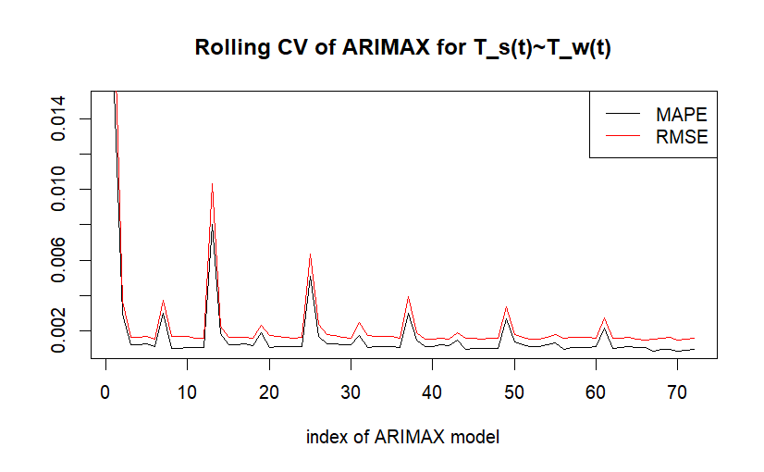
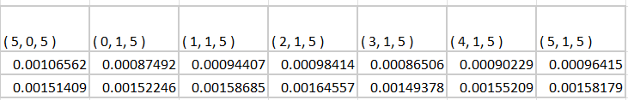
T_s(t): ARIMAX(3,1,5), with xreg=T_w

Slide 21
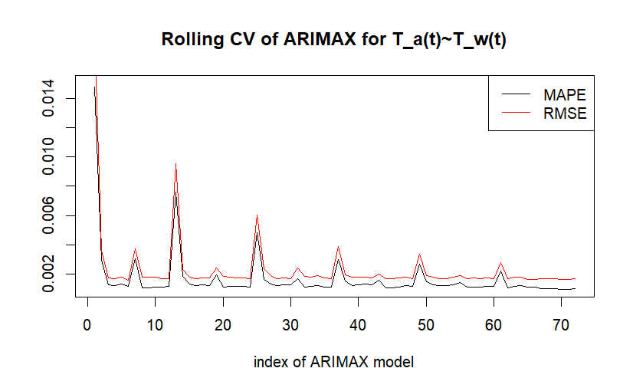
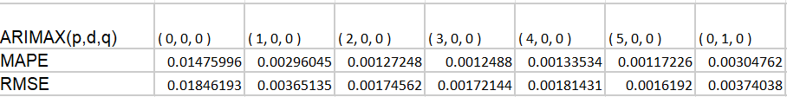
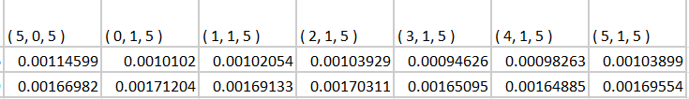
T_s(t): ARIMAX(3,1,5), with xreg=T_a

Slide 22
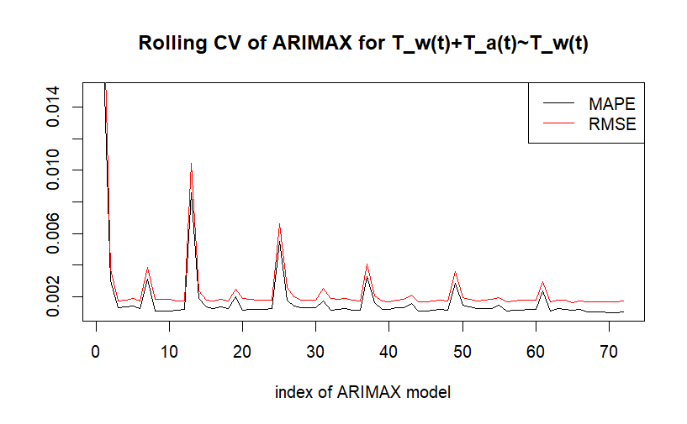
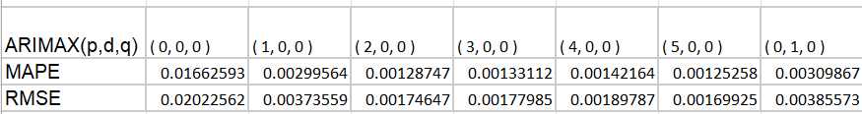
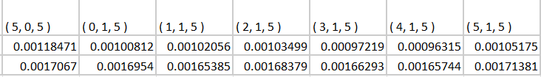
T_s(t): ARIMAX(4,1,5), with xreg=c(T_a,T_w)

Slide 23
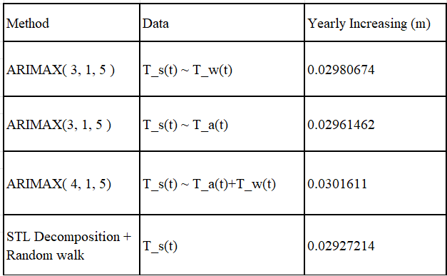
Forecast Result: Next Year Sea Level Trend

Slide 24
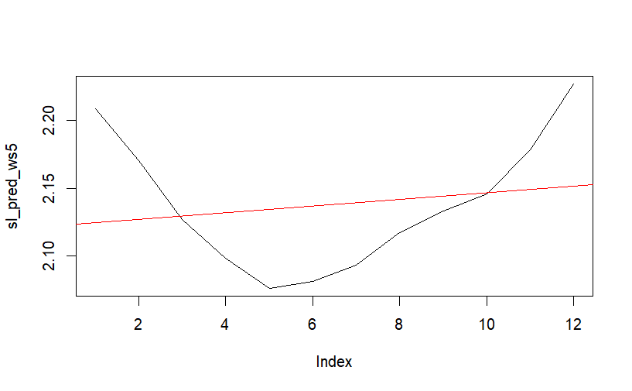
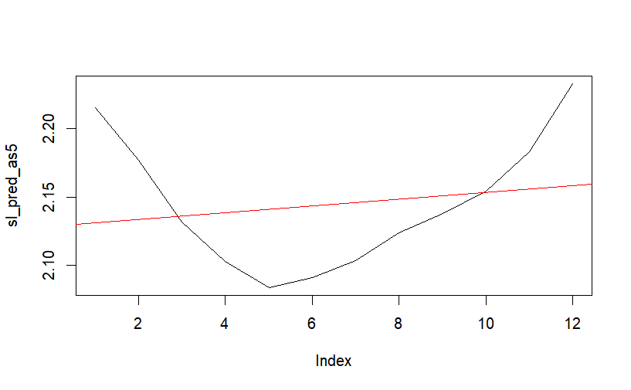
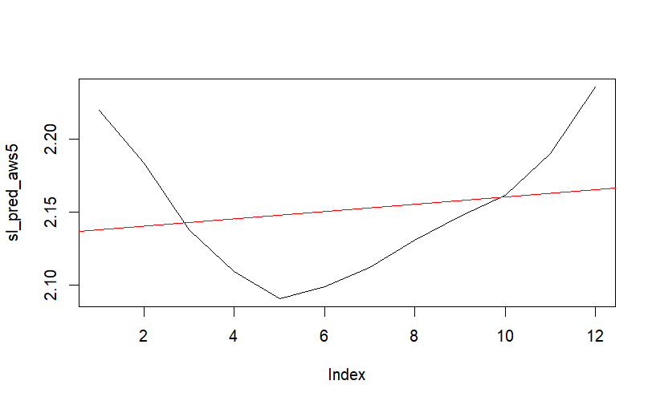
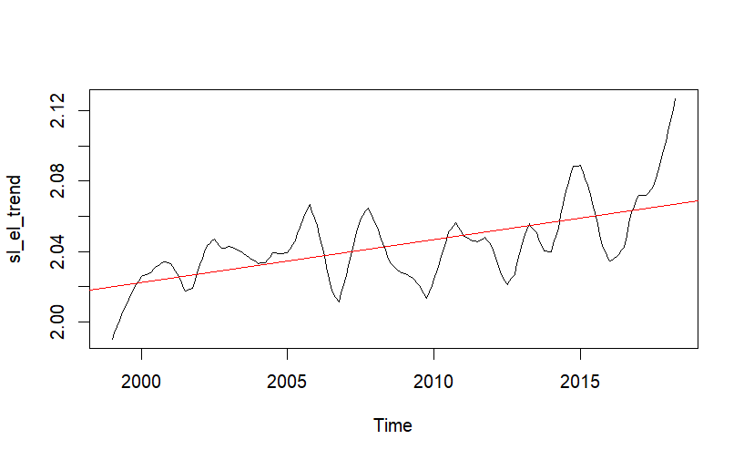
Forecast sea level trend by ARIMAX(3,1,5) with xreg=water temp trend
Forecast sea level trend by ARIMAX(3,1,5) with xreg=air temp trend
Forecast sea level trend by ARIMAX(3,1,5) with xreg=c(air temp trend, water temp trend)
Forecast sea level trend by using STL decomposition trend component of sea level data

Slide 25

References
Aung, Than, et al. “Sea Level Threat in Tuvalu.” American Journal of Applied Sciences, vol. 6, no. 6, June 2009, pp. 1169–74, doi:https://doi.org/10.3844/ajassp.2009.1169.1174.
Caldwell, P. C., M. A. Merrifield, P. R. Thompson, Sea level measured by tide gauges from global oceans — the Joint Archive for Sea Level holdings (NCEI Accession 0019568), Version 5.5, NOAA National Centers for Environmental Information, Dataset, 2015, doi:10.7289/V5V40S7W.
Cooley, Sarah, et al. "Oceans and coastal ecosystems and their services." IPCC AR6 WGII. Cambridge University Press, 2022, p. 393. https://awi.eprints-hosting.org/id/eprint/56137/1/IPCC_AR6_WGII_Chapter03.pdf
Current and Future Climate of Tuvalu. 4 Jan. 2014, https://world.350.org/pacific/files/2014/01/4_PCCSP_Tuvalu_8pp.pdf.
Fisheries Department | Tuvalu Fisheries. https://tuvalufisheries.tv/tag/fisheries-department/. Accessed 20 Mar. 2023.
G, Vijay Kumar. “Stationarity: Statistical Tests to Check Stationarity in Time Series.” Analytics
Vidhya, 14 Mar. 2023, https://www.analyticsvidhya.com/blog/2021/06/statistical-tests-to-check-stationarity-in-time-series-part-1/.
Gallagher, Sean. “Seas Rise, Hope Sinks: Tuvalu’s Vanishing Islands – in Pictures.” The
Guardian, 27 May 2019, www.theguardian.com/global-development/gallery/2019/may/27/seas-rise-hope-sinks-tuvalu-vanishing-islands-in-pictures.
Hunter, John., “A note on Relative Sea Level Change at Funafuti, Tuvalu.” Antarctic
Cooperative Research Centre. University of Tasmania, 2002, p. 25. http://staff.acecrc.org.au/~johunter/tuvalu.pdf
Hyndman, R.J., & Athanasopoulos, G. Forecasting: principles and practice, 2nd edition, OTexts: Melbourne, Australia. 2018. OTexts.com/fpp2.
Mushtaq, Rizwan. “Augmented Dickey Fuller Test.” SSRN, 17 Aug. 2011, https://papers.ssrn.com/sol3/papers.cfm?abstract_id=1911068.
NOAA Fisheries. “National Fishery Sector Overview Tuvalu| NOAA Fisheries.” Noaa.gov, Jan. 2010, www.fisheries.noaa.gov/about-us.
Riebeek, Holli. “Global Warming.” Nasa, NASA Earth Observatory, 3 June 2010, https://earthobservatory.nasa.gov/features/GlobalWarming
Singh, Awnesh, and Than Aung. “Effect of Barometric Pressure on Sea Level Variations in the Pacific Region.” The South Pacific Journal of Natural and Applied Sciences, vol. 23, no. 1, 2005, p. 9, doi:https://doi.org/10.1071/sp05002.
Ouyang, Zuokun, et al. “STL Decomposition of Time Series Can Benefit Forecasting Done by Statistical Methods but Not by Machine Learning Ones.” MDPI, Multidisciplinary Digital Publishing Institute, 8 July 2021, https://www.mdpi.com/2673-4591/5/1/42.

